Slide 1
Introduction
0750323 Algorithms
Dr. Raneem Qaddoura

Slide 2
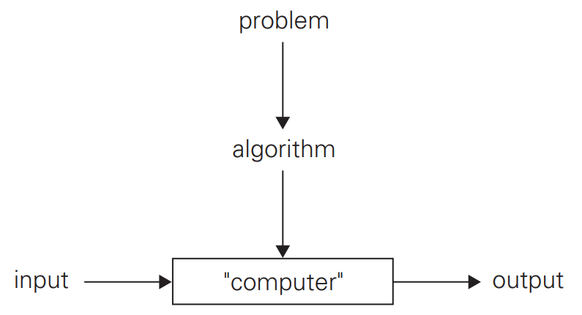
What is an algorithm?
An algorithm is a sequence of unambiguous instructions for solving a problem, i.e., for obtaining a required output for any legitimate input in a finite amount of time.

Slide 3
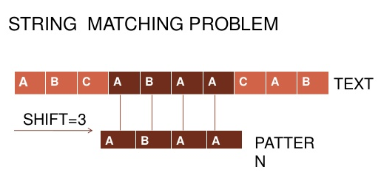
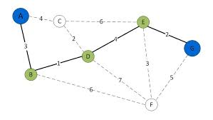
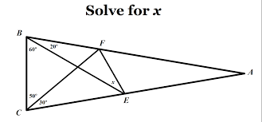
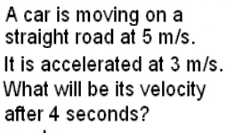
Important problem types
Sorting
Searching
String processing
Graph problems
Geometric problems
Numerical problems

Slide 4
Example of computational problem: sorting
Statement of problem:
Input: A sequence of n numbers < a₁, a₂, …, a_{n} >
Output: A reordering of the input sequence sequence <a´₁, a´₂, …, a´_{n}> so that a´_{i} ≤ a´_{j} whenever i < j
Instance: The sequence <5, 3, 2, 8, 3>
Algorithms:
Selection sort
Insertion sort
Merge sort
(many others)

Slide 5
Selection Sort
Input: array a[1],…, a[n]
Output: array a sorted in non-decreasing order
Algorithm:
for i=1 to n
swap a[i] with smallest of a[i],… a[n]

Slide 6
No single algorithm fits all situations best!
Sorting
Some of the algorithms are simple but relatively slow, while others are faster but more complex
Some work better on randomly ordered inputs, while others do better on almost-sorted lists
Some are suitable only for lists residing in the fast memory, while others can be adapted for sorting large files stored on a disk
Searching
Some algorithms work faster than others but require more memory
Some are very fast but applicable only to sorted arrays
In applications where the underlying data may change frequently relative to the number of searches, searching has to be considered in conjunction with two other operations: an addition to and deletion from the data set of an item.
Organizing very large data sets for efficient searching poses special challenges with important implications for real-world applications.

Slide 7
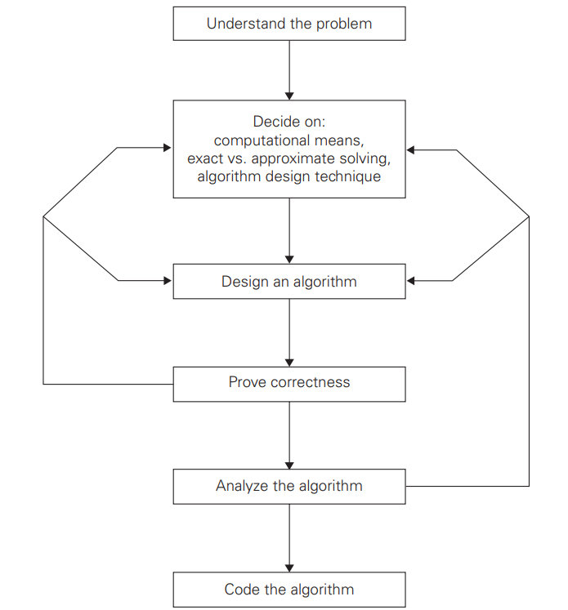
Algorithm design and analysis process
Understand the problem
Decide on: computational means, exact vs. approximate solving, algorithm design technique
Design an algorithm (Natural language, pseudocode, flowchart)
Prove correctness
Analyze the algorithm and data structure
Efficiency (time & space)
Simplicity
Generality
Code the algorithm

Slide 8
Algorithm design strategies
Brute force
Divide and conquer
Decrease and conquer
Transform and conquer
Greedy approach
Dynamic programming
Backtracking and branch-and-bound

Slide 9
Why need algorithm analysis?
Writing a working program is not good enough
The program may be inefficient!
If the program is run on a large data set, then the running time becomes an issue

Slide 10
Fundamental Data structures
A data structure can be defined as a particular scheme of organizing related data items.
The nature of the data can range from data types (e.g., integers or characters) to data structures (e.g., one-dimensional array)
Data Structures
Lists (array, string, linked list, stack, queue)
Graphs
Trees
Sets

Slide 11
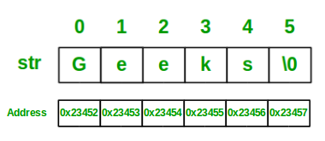
Linear Data Structures
A linear list or simply a list is a finite sequence of data items, i.e., a collection of data items arranged in a certain linear order
A (one-dimensional) array is a sequence of n items of the same data type that are stored contiguously in computer memory and made accessible by specifying a value of the array’s index
A string is a sequence of characters from an alphabet terminated by a special character indicating the string’s end.
A linked list is a sequence of zero or more elements called nodes, each containing two kinds of information: some data and one or more links called pointers to other nodes of the linked list.
Singly linked list
Doubly linked list

Slide 12
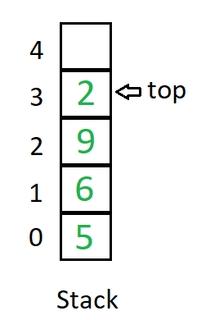
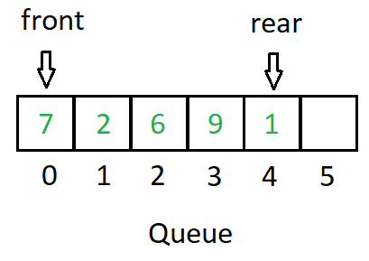
Linear Data Structures
A linear list or simply a list is a finite sequence of data items, i.e., a collection of data items arranged in a certain linear order
A stack is a list in which insertions and deletions can be done only at the end (top)
last-in–first-out (LIFO)
A queue is a list from which elements are deleted from one end of the structure, called the front, and new elements are added to the other end (rear)
first-in–first-out (FIFO)

Slide 13
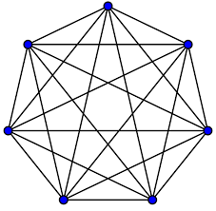
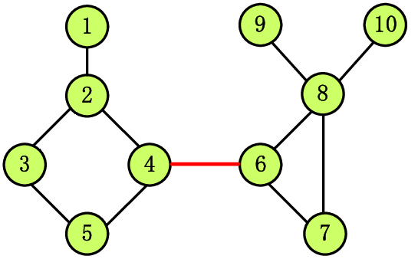
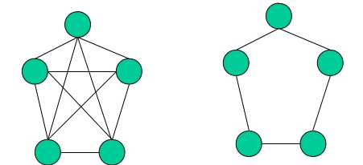
Graphs
A graph is informally thought of as a collection of points in the plane called “vertices” or “nodes,” some of them connected by line segments called “edges” or “arcs.”
Formally, a graph G = ‹V,E› is defined by a pair of two sets: a finite nonempty set V of items called vertices and a set E of pairs of these items called edges.
Undirected vs directed graphs
Complete graph
Connected graph
Dense vs sparse graphs

Slide 14
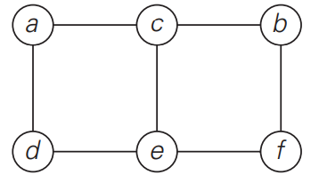
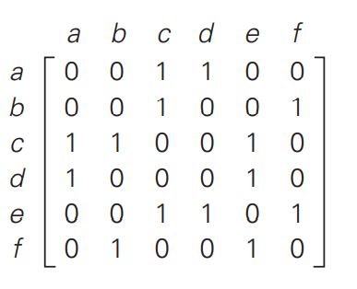
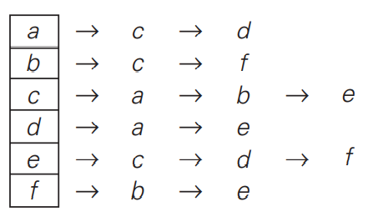
Graphs Representations
The adjacency matrix of a graph with n vertices is an n × n boolean matrix with one row and one column for each of the graph’s vertices, in which the element in the ith row and the jth column is equal to 1 if there is an edge from the ith vertex to the jth vertex, and equal to 0 if there is no such edge.
The adjacency lists of a graph or a digraph is a collection of linked lists, one for each vertex, that contain all the vertices adjacent to the list’s vertex (i.e., all the vertices connected to it by an edge).

Slide 15
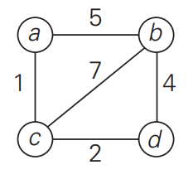
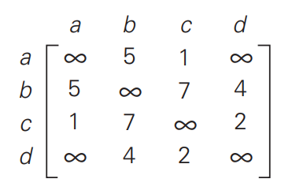
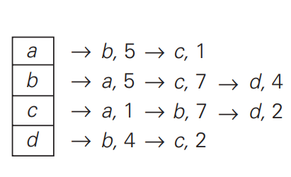
Graphs
A weighted graph (or weighted digraph) is a graph (or digraph) with numbers assigned to its edges.
These numbers are called weights or costs.
An interest in such graphs is motivated by numerous real-world applications, such as finding the shortest path between two points in a transportation or communication network or the traveling salesman problem.

Slide 16
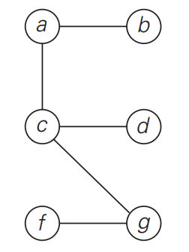
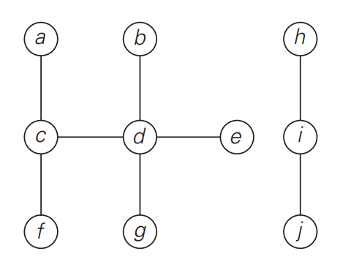
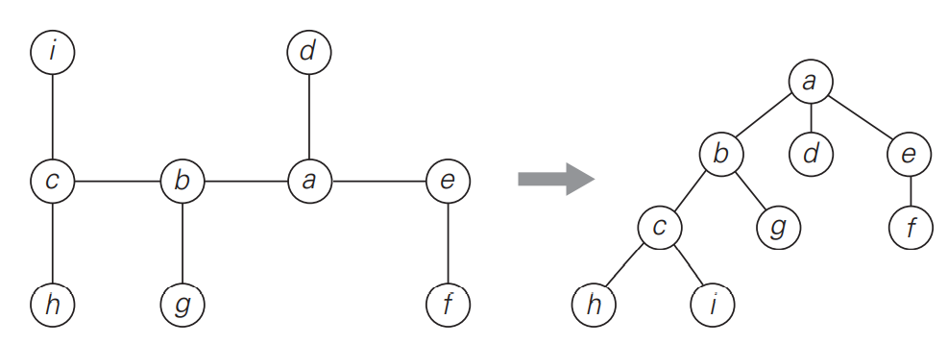
Trees
A tree (more accurately, a free tree) is a connected acyclic graph
A graph with no cycles is said to be acyclic
A graph that has no cycles but is not necessarily connected is called a forest: each of its connected components is a tree
For every two vertices in a tree, there always exists exactly one simple path from one of these vertices to the other.
Select an arbitrary vertex in a free tree and consider it as the root of the so-called rooted tree.

Slide 17
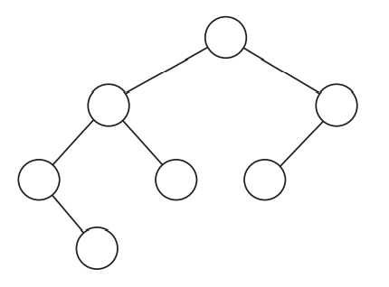
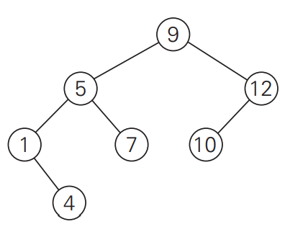
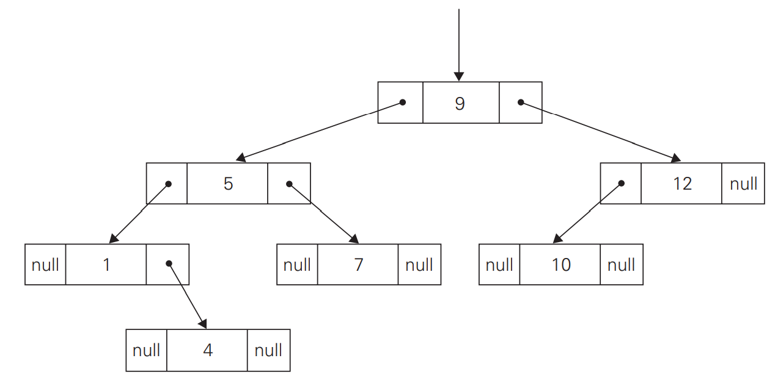
Trees
Ordered Trees An ordered tree is a rooted tree in which all the children of each vertex are ordered. It is convenient to assume that in a tree’s diagram, all the children are ordered left to right.
A binary tree can be defined as an ordered tree in which every vertex has no more than two children and each child is designated as either a left child or a right child of its parent; a binary tree may also be empty.
A number assigned to each parental vertex is larger than all the numbers in its left subtree and smaller than all the numbers in its right subtree. Such trees are called binary search trees.

Slide 18
Sets
In mathematic, a set can be described as an unordered collection (possibly empty) of distinct items called elements of the set.
A set is represented by:
bit vector (011010100 for S = {2, 3, 5, 7} if U= {1, 2, 3, 4, 5, 6, 7, 8, 9} and S is a subset of U )
list

Slide 19
References
Levitin, A. (2011). Introduction to the design & analysis of algorithms. Boston: Pearson.

